Slide 1

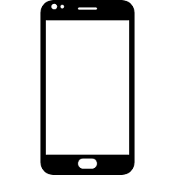
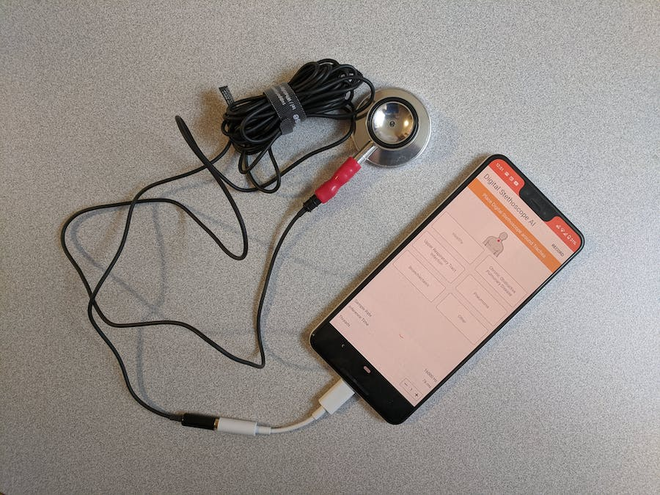
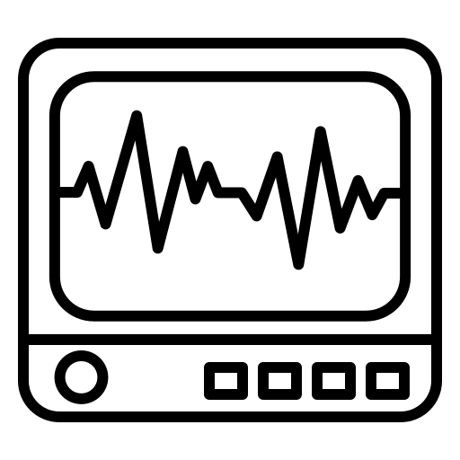
Smartphone as Stethoscope
PCG
Mobile
Low-end
High-end
ECG
Better
MIC
PCG
IMU
How to improve PCG recording?
Measurement: drawbacks of mobile device.
Extra information from IMU, PPG.
Data scarcity if deep learning.
PPG

Slide 2
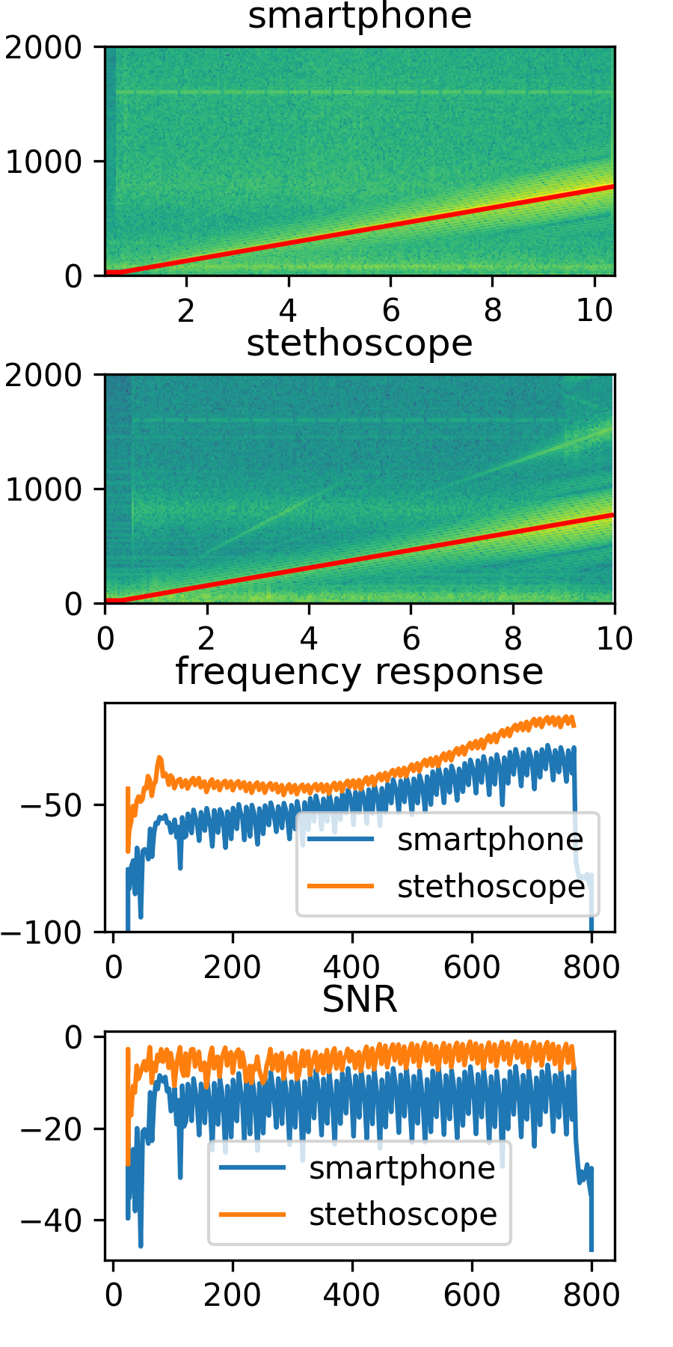
Measurement - Chirp
Heart sound sample
Stethoscope has higher gain and SNR.
The advantage is more obvious in low-frequency band, which is also the main components of heart sound.
IMU (low-pass filter) may help!

Slide 3

Measurement - Heart sound playback
Public
Dataset
Speaker
Pros:
Collect data easily.
Diverse dataset from patients.
Cons:
Gap between real data.
We lose the PPG modality.
ARSteth @IPSN’23

Slide 4

Dataset from simulation & reality
Public
Dataset
Reference
Loss/Metric
Metric
Speaker
DNN
DNN
Training & Validation
Test only

Slide 5
Playback Simulation: Multi-modal
Problem: We can hardly record vibration by IMU.
Solution: Silicone-made medical skin
Problem: There is no corresponding PPG signal during playback.
Solution: Pending.

